Slide 1
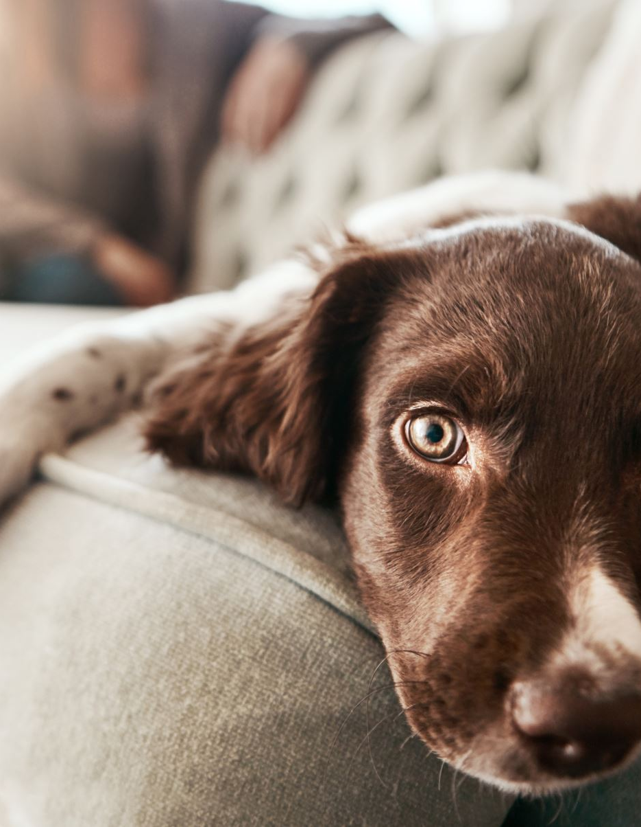
Explain it to me like I’m 5: Instruction Cycle analogy using dogs
Jaiden Gann
Kasey Sager
Christy Dillon
Haley Maddox
Notes:
In order to execute an instruction: they all start out the same way. The instruction is fetched, 2 registers are read, and the instruction is decoded. Afterwards depending on what needs to be done in the execution stage for the instruction the next steps will vary.

Slide 2
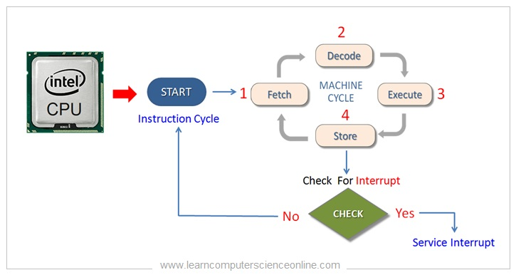
Overview

Slide 3
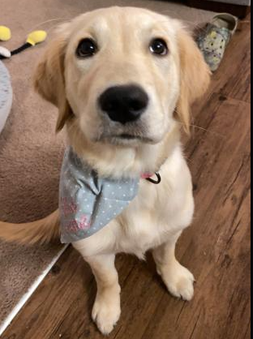
Overview
In this video, we are going to explain a very simple overview of how an instruction goes through its cycle using the analogy of a dog getting hungry.

Slide 4

Jack the dog gets Jane the human’s attention
Notes:
Here we are going to explain a very simple overview of how an instruction goes through using the analogy of a dog getting hungry. The dog’s want acts as the instructions and the human is the PC. Thought processes and other actions done by the human are then the hardware necessary to do what the instructions calls for.

Slide 5

Jane considers why Jack would want her attention

Slide 6

Jack must be hungry!

Slide 7



Jane opens a can of food for Jack

Slide 8
Jane puts the dog food in Jack’s bowl

Slide 9
Jack happily eats his food and Jane returns to what she was doing

Slide 10
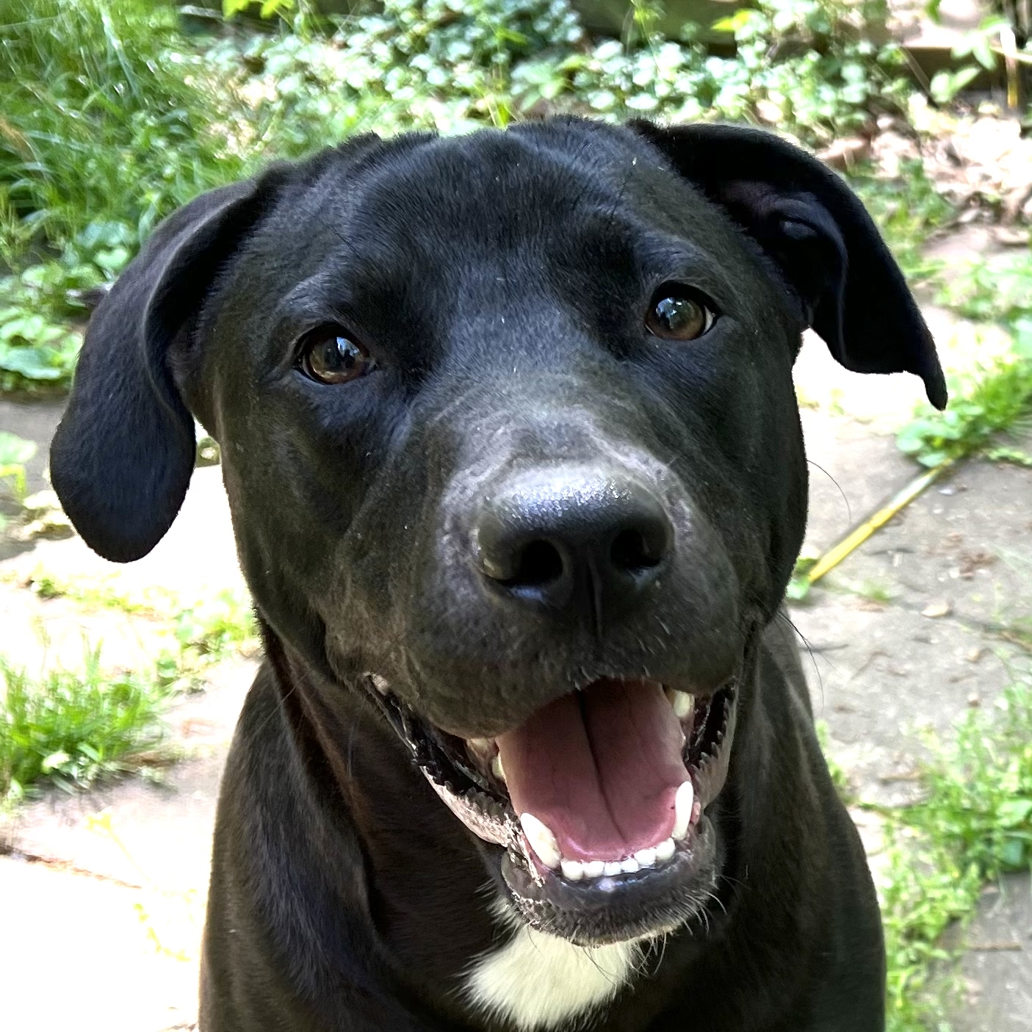
The end

